Slide 1



BY/ Mohamed Fandoud
Hagar Mostafa
Mahmoud Shehata
Hanan Sherif
Abdelaziz Ahmed
Hany Mahmoud

Slide 2



Dataset
Toy Store
Data Overview, Data Structure, ETL , Modeling, Key metrics analysis & visualization.
Our Agenda
Mission & Objective
Our mission & Primary objective
Sales Dashboard
Presenting Dashboard & concluded insigths

Slide 3


Toy Store
About Dataset
Sales & inventory data for a fictitious chain of toy stores in Mexico called Maven Toys, including information about products, stores, daily sales transactions, and current inventory levels at each location.

Slide 4





Data Overview
Calendar Table
•This table includes all relevant dates, allowing for time-based analysis of sales trends and performance metrics.
Inventory Table
•Contains information on the stock levels of toys available at each store.
Products Table
•Lists all products available in the store, including their categories, costs, and prices.
Sales Table
•Captures transaction details, including sales dates, quantities sold, and associated stores.
Stores Table
•Contains details about each store location, including its name, city, and operational status.

Slide 5
Data Structure
Calendar | Inventory | Sales | Products | Stores
Key Fields: Date | Key Fields: Store_ID Product_ID Stock_On_Hand | Key Fields: Sale_ID, Date Store_ID Product_ID Units | Key Fields: Product_ID Product_Name Product_Category Product_Cost, Product_Price. | Key Fields: Store_ID Store_Name Store_City Store_Location Store_Open_Date.

Slide 6




ETL
Extract
Data excracted from Maven Analytics with csv format
Transform
Perform transformations like:
Filtering rows (e.g., removing nulls or irrelevant data).
Replacing values (e.g., handling missing data).
Splitting columns or merging columns.
Pivoting/Unpivoting data for better structure.
Grouping data for aggregations (sum, count, etc.).
Data Type Conversion: Ensure correct data types (e.g., dates, decimals).
Adding custom columns with calculated fields using Power Query’s M language.
Load
After transformation, load the cleaned data into Power BI's data model for reporting.

Slide 7

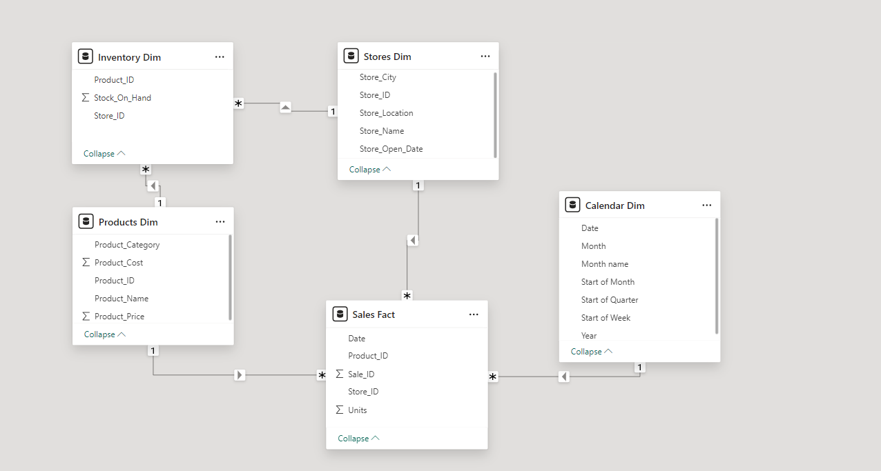
Data Modeling
After ETL, Power BI allows you to create relationships between tables, define measures, and optimize the data model for analysis:
•Create relationships between different data sources (e.g., fact and dimension tables).

Slide 8

Key Metrics to Be Analyzed
Sold Units
Previous Month Metrics
Profit
Orders
Adjusted Price
Revenue
Adjusted Revenue
Adjusted Profit
Average Retail Price
Stock on Hand
Sold Units
Store Count
Profit Margin
Previous Month Metrics
Total Cost
Inventory Cost

Slide 9

Key Visualization
Sales Performance
Inventory Analysis
Profitability Analysis
Comparative Metrics

Slide 10

Toy Store
Our Mission
•we aim to maximize customer satisfaction and profitability through effective inventory management and targeted sales strategies.
Is to provide high-quality, engaging toys that promote creativity and learning in children. With multiple stores across various locations.

Slide 11

Objectives of the Analysis
Sales Performance Evaluation
Inventory Management
To assess overall sales trends and identify peak sales periods, particularly around holidays and promotional events.
To analyze stock levels across different stores, ensuring that popular items are adequately stocked while minimizing excess inventory.
Profitability Insights
Comparative Analysis
To evaluate profit margins across different product categories and identify best-selling items that contribute significantly to overall revenue.
To compare current month performance against previous months, helping to identify growth trends and areas for improvement.

Slide 12

Toy Store
Dashboard
Key findings:
Overall sales and profit growth
Strong performance of specific product categories and stores
Opportunities for inventory optimization
10K+
1K+
75K
Advertising
Production
Others Thing

Slide 13

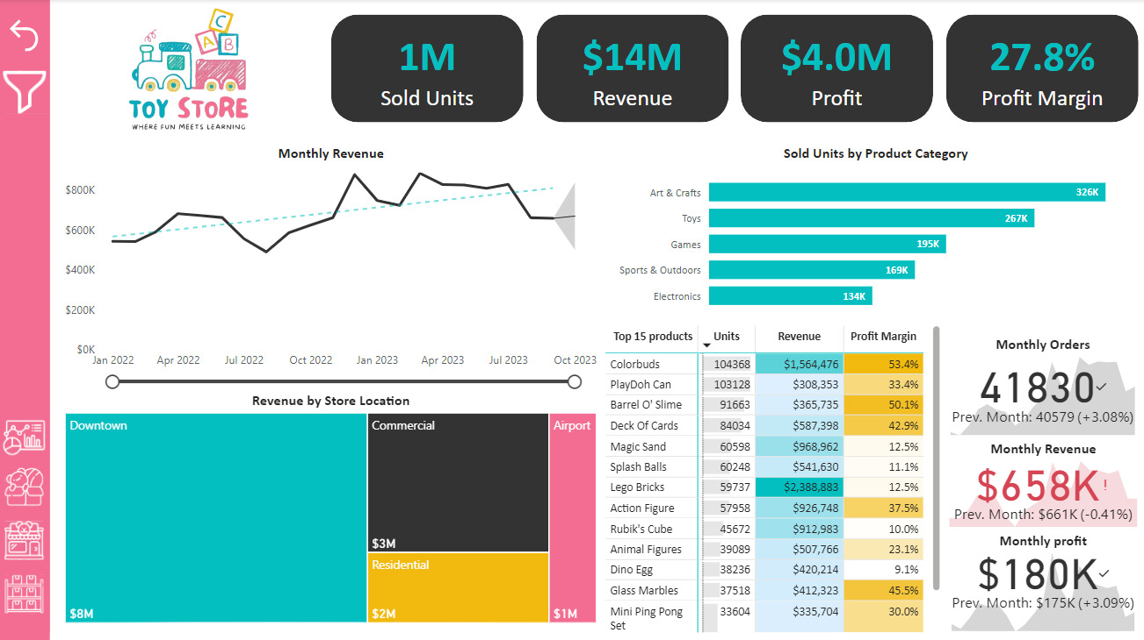

Overall Performance
Key metrics:
Total sales
Total revenue
Total profit
Profit margin
Highlight:
Growth trends and stability of profit margin

Slide 14

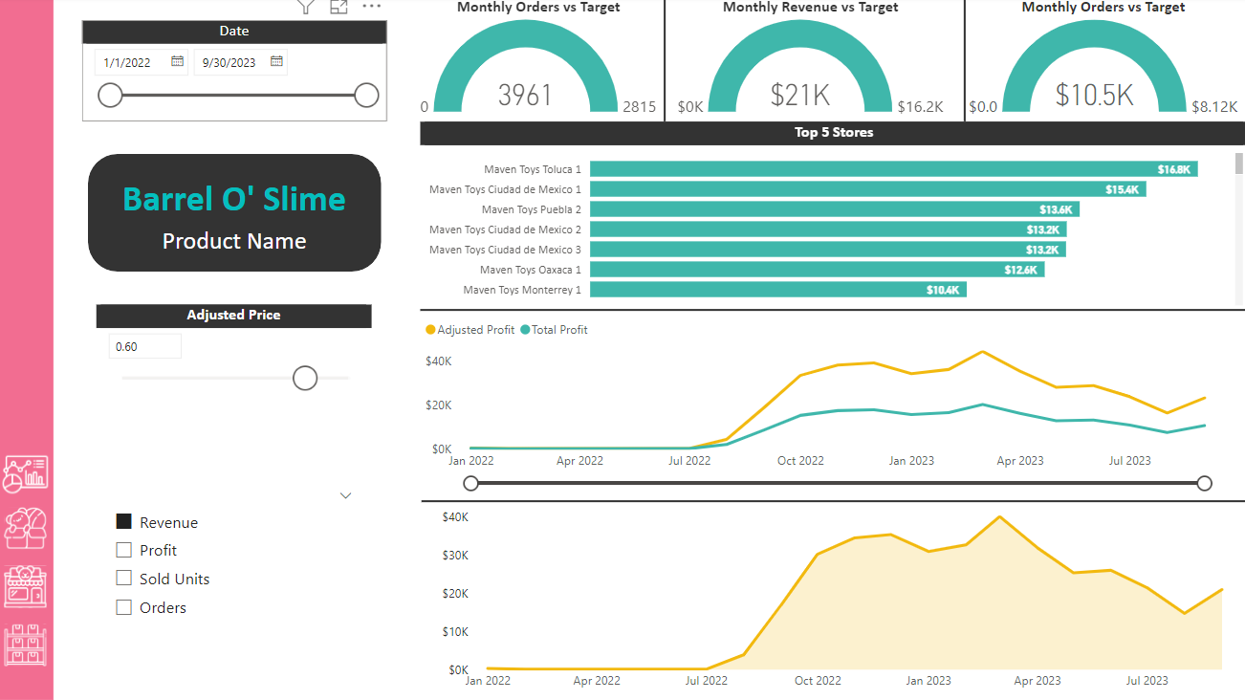
Product Performance
Key metrics:
Units sold
Revenue
Profit margin
Highlight:
Top-selling categories and products

Slide 15

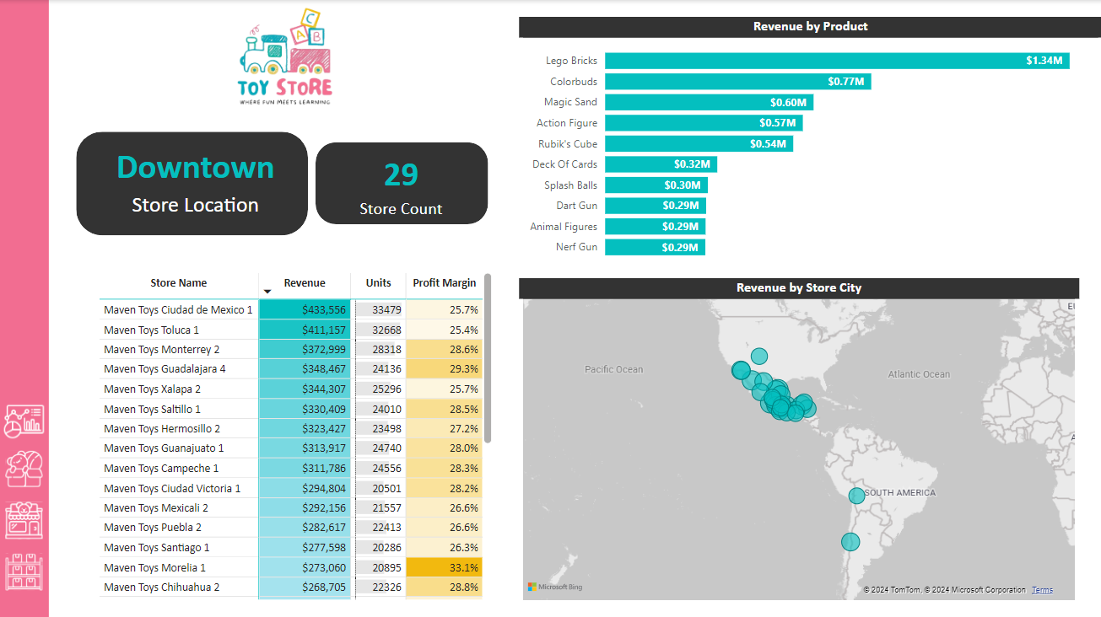
Store Performance
Key metrics:
Revenue
Store count
Highlight:
High-performing locations and potential areas for improvement

Slide 16

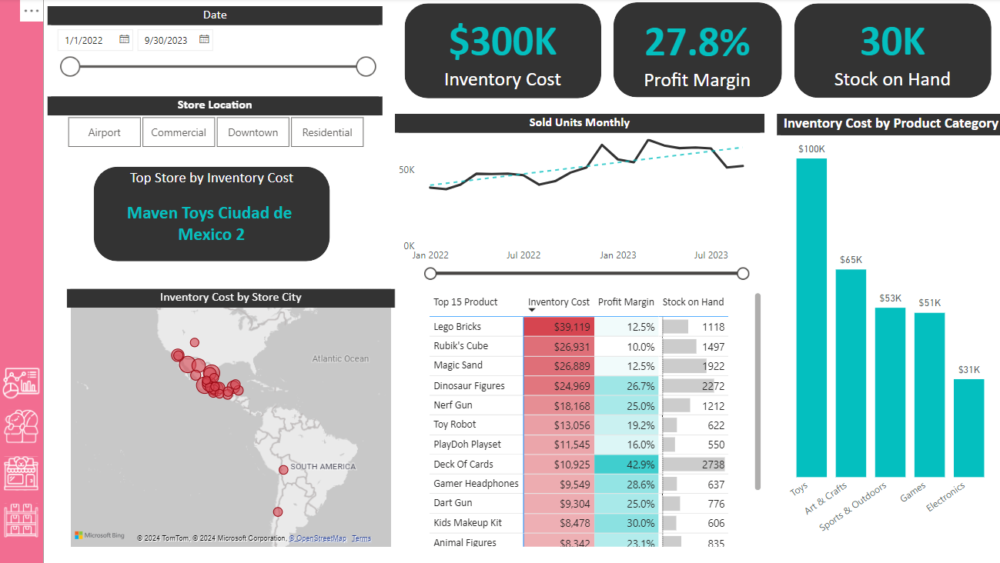
Inventory Analysis
Key metrics:
Total inventory cost
Average profit margin
Total stock on hand
Highlight:
Inventory management challenges and opportunities

Slide 17


Conclusions and Recommendations
Key Findings:
Art & Crafts: High sales volume, potential for further growth.
Colorbuds: Best profit margin, ensure adequate stock and marketing.
Inventory Management: Optimize practices to reduce costs and avoid stockouts.
Downtown Success: Identify factors driving sales and replicate in other locations.
Toluca 1: Analyze success factors and apply lessons to other stores.
Recommendations:
Promote Art & Crafts: Introduce new products, create bundles.
Focus on Colorbuds: Ensure ample stock, feature in marketing.
Optimize Inventory: Review management practices, avoid overstocking.
Learn from Downtown: Analyze factors driving success, replicate in other locations.
Invest in Toluca 1: Support with marketing, inventory, and analysis.

Slide 18
THANK YOU
For Your Attention

